Slide 1
Front End Development
Task - 2

Slide 2
CALCULATOR AND TEXT EDITOR
In this project, we are going to discuss how to develop a Real-Time Calculator and how to make a simple text editor using HTML,CSS and JavaScript.
LMS Username | Name | Batch
2115a755 | A.R.ASWATHA | A7
2115a726 | G.S.KOSHIGA | A7
2115a728 | C.KRITHIKA | A7
2115a730 | R.NARMADHA | A7

Slide 3
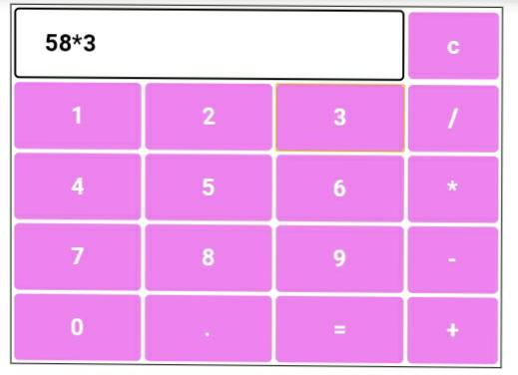
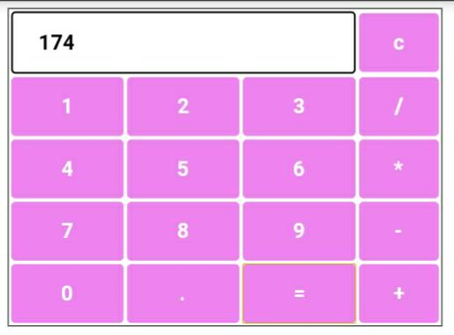

Slide 4
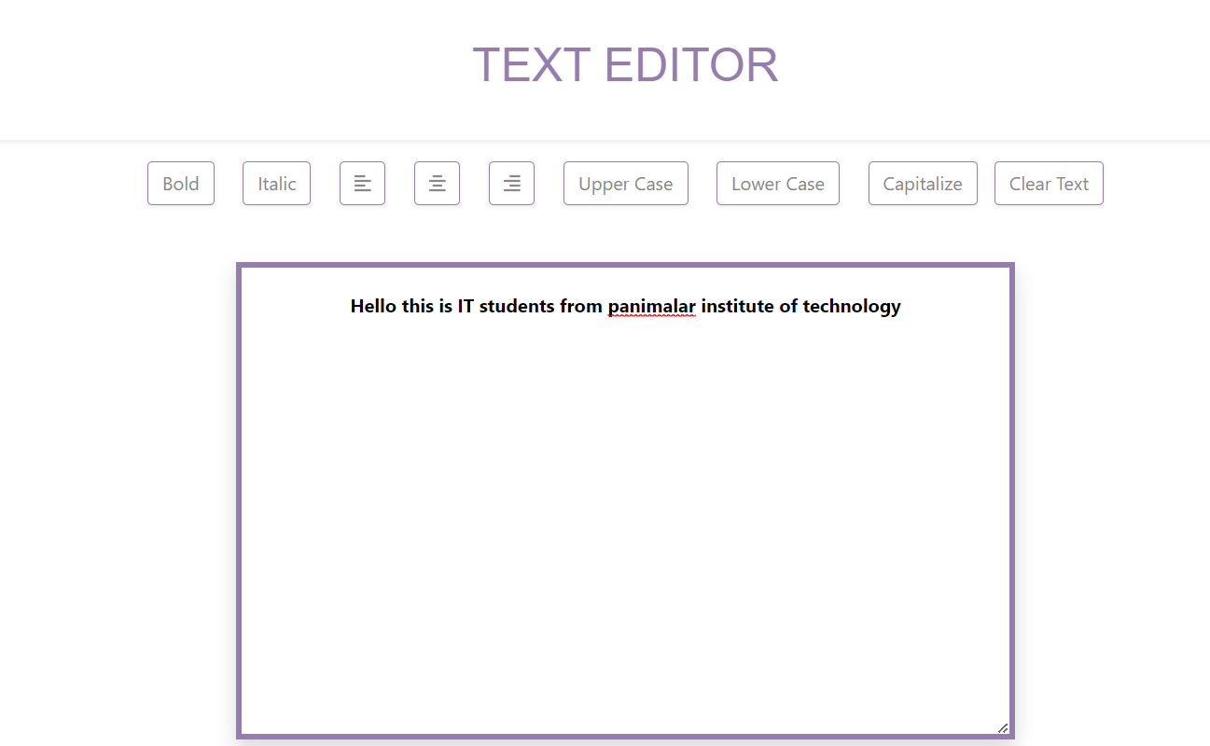

Slide 5
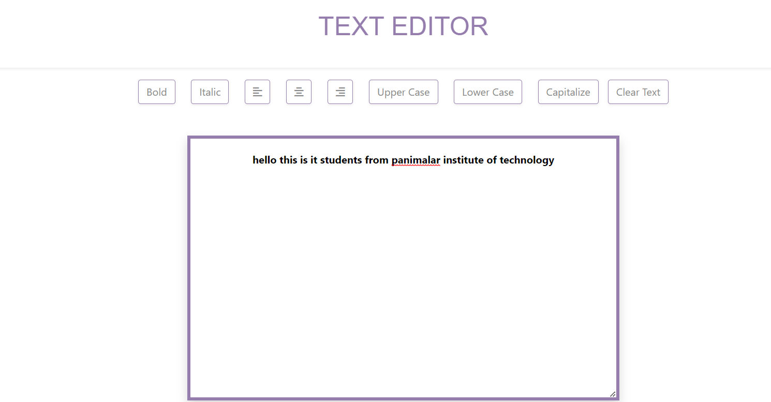

Slide 6
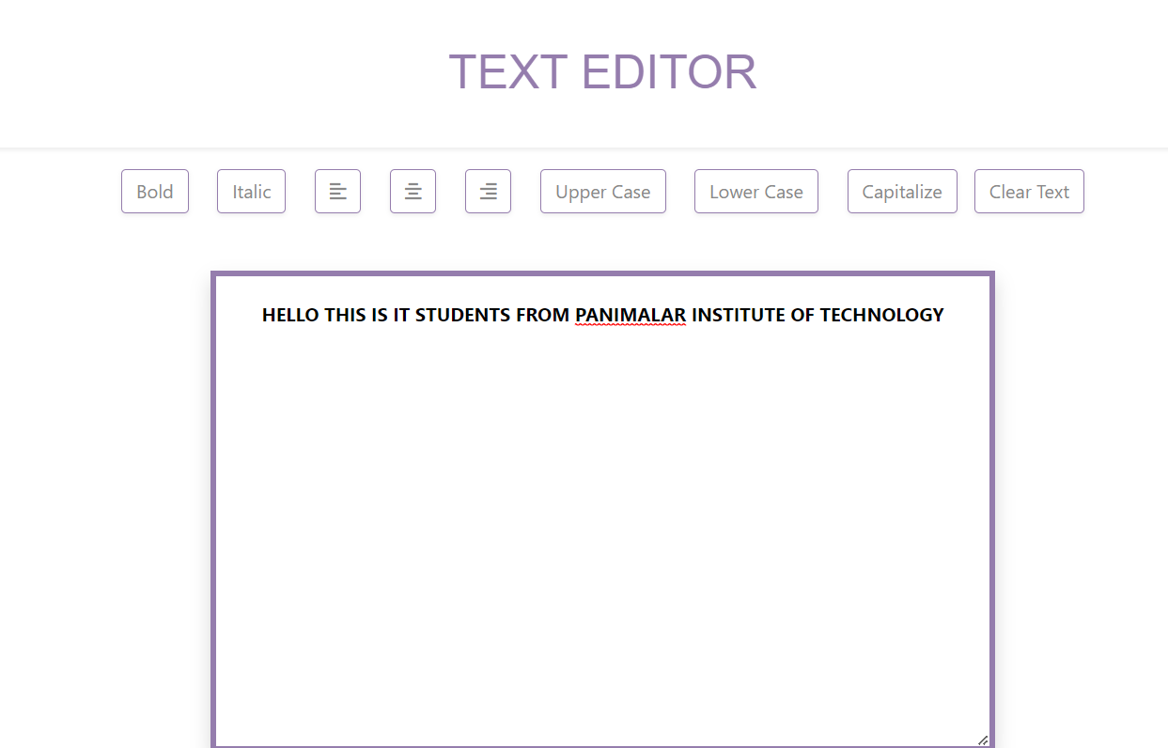

Slide 7
SUMMARY OF TEXT EDITOR:
The concept of this TEXT EDITOR project is to edit the text whatever we give as input Here the code runs on HTML and called using JAVASCRIPT. The DOM(Document object Model) method is used.This webpage is designed using html tags such as <html>, <head>, <title> etc...It contains totally nine function which are listed below:
Function 1: Bold
This function is used to display the text in bold.
Function 2: Italic
This function is used to display the text in italics
Function 3: Left align
This function is used to align the text on the left side of the page
Function 4: Center align
This function is used to align the text on the centre of the page
Function 5: Right align
This function is used to align the text on the right side of the page
Function 6: Uppercase
This function is used to convert the text into uppercase letters
Function 7: Lowercase
This function is used to convert the text into lowercase letters
Function 8: Capitalise
This function is used to convert the text into lowercase letters
Function 9: Clear Text
This function is used to convert the text back to it's original form as given before editing.

Slide 8
SUMMARY OF CALCULATOR:
● To design the basic calculator, we will use HTML, CSS, and JavaScript.
● HTML is used to design the basic structure of the calculator.
● CSS styles are used to apply styles on the calculator and JavaScript is used to add the calculation functionality.
● Initially a table is created using attributes such as:
▪︎ Margin- css margins are used to create space around the element.
▪︎ Padding - CSS paddings are used to create space around the element, inside any defined border.
▪︎ Border-width- The border-width property sets the width of an element's four borders.
▪︎ Rowspan- The rowspan attribute is for merging rows of the table.
▪︎ Colspan- the colspan attribute is for merging columns of the table.
● The input type as text to define a single line text field . An on-click function is also included in order to display the numbers which ever the users click to perform the operation and the input type is given as button Arithmetic operations such as Addition, Subtraction, Multiplication, Division can be performed using map functions.

Slide 9
Submission Github
https://github.com/Koshiga17/front-end-development.git

Slide 10


